Slide 1
Software Quality Assurance (SQA) Lecture 1
Introduction to course

Slide 2
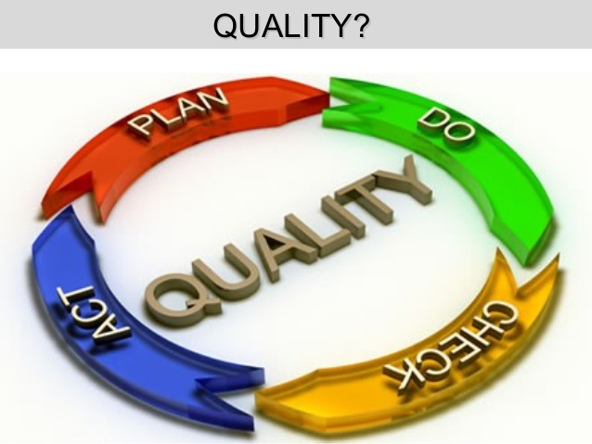

Slide 3

It is not the “goodness” or “elegance” but “conformance to requirements” (Crosby)
“fitness for use” (Juran)
Ultimately: “Customer Satisfaction”

Slide 4
Software Quality is
The degree to which a system, component, or process meets specified requirements, and
The degree to which a system, component, or process meets customer or user needs or expectations. (IEEE)
Quality is:
The totality of features and characteristics of a product or service that bear on its ability to satisfy specified or implied needs.
(ISO)

Slide 5
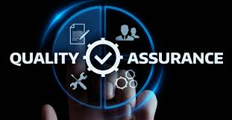
Software Quality Assurance (SQA):
Software Quality Assurance (SQA) is
(1) A planned and systematic pattern of all actions necessary to provide adequate confidence that an item or product conforms to established technical requirements.
(2) A set of activities designed to evaluate the process by which products are developed or manufactured.
(IEEE 610)

Slide 6
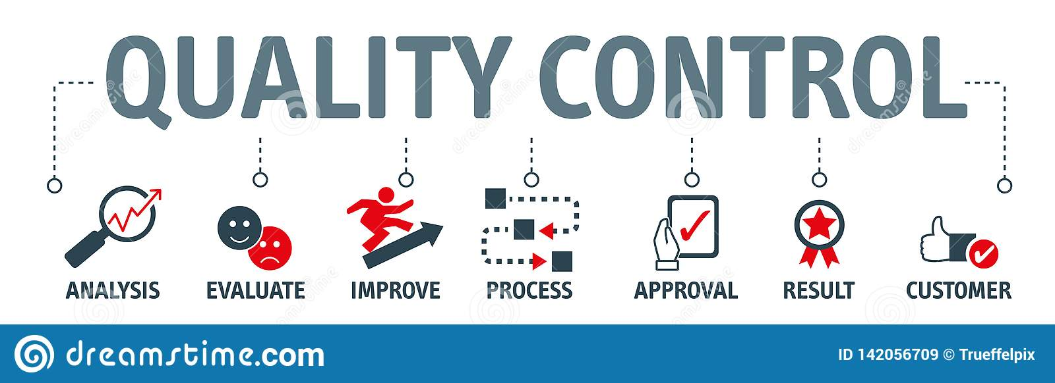
Quality Control (QC):
Quality control can be defined as "part of quality management focused on fulfilling quality requirements."
“The operational techniques and activities used to fulfill requirements for quality."
A system of maintaining standards in manufactured products by testing a sample of the output against the specification.

Slide 7
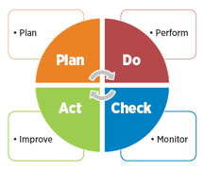

Slide 8
More on Quality...
Quality is not absolute - it means different things in different situations
Quality is multidimensional - it has many contributing factors and cannot be easily summarized
Quality is subject to constraints - assessment is constrained by cost (of many types)
Quality is about acceptable compromises - when quality is constrained, compromises are required.
Quality criteria are not independent - they interact with each other and cause conflicts.

Slide 9
Quality in business context:
Quality is a competitive issue now
Quality is a must for survival
Quality gives you the global reach
Quality is cost effective
Quality helps retain customers and increase profits
Quality is the hallmark of world-class business

Slide 10
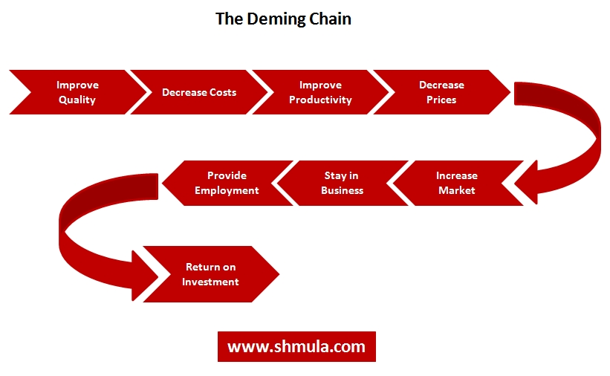

Slide 11
Cost of Quality:
Cost of Conformance
Prevention Costs
(Build a quality product)
• Training
• Document processes
• Equipment
• Time to do it right
Appraisal Costs
(Assess the quality)
• Testing
• Destructive testing loss
• Inspections
Money spent during the project to avoid failures
Cost of Nonconformance
Internal Failure Costs
(Failures found by the project)
• Rework
• Scrap
External Failure Costs
(Failures found by the customer)
•Liabilities
• Warranty work
• Lost business
Money spent during and after the project because of failures

Slide 12
Some more concepts:
Quality and Grade
Precision
Accuracy
Gold Plating
Continuous Improvement
Customer Satisfaction
Prevention over inspection
Management Responsibility
Quality is planned in,
not inspected in

Slide 13
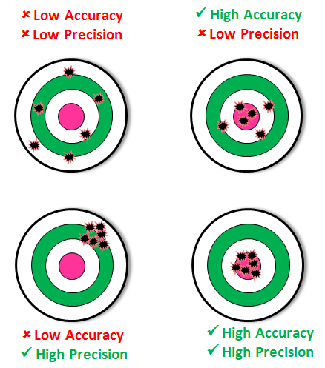
Precision Vs Accuracy

Slide 14
CONTINEOUS VS CONTINUAL ‘Improvement’

Slide 15
8 Quality Principles by ISO
Customer Focus
Leadership
Involvement of People
Process Approach
System Approach to Management
Continual Improvement
Factual Approach to Decision Making
Mutually beneficial supplier relationship

Slide 16
Thank You

